Slide 1
Getting a Good Start in a SYSCO Race Michael Morrissey, Merit 25 Fleet
One place on the race course that guarantees boats will come together.
Can be terrifying for newcomers but will test your skill as a racer and should be fun if you know what to look for.

Slide 2
Basic Preparation for a good start
Know the conditions – wind and current
Give your crew assignments
Know the favored end of the line
Have a general strategy of how you want to sail the first leg
Be there
Sail fast, clear air and headed in the right direction
Be ready to adjust after a poor start
Know the rules

Slide 3
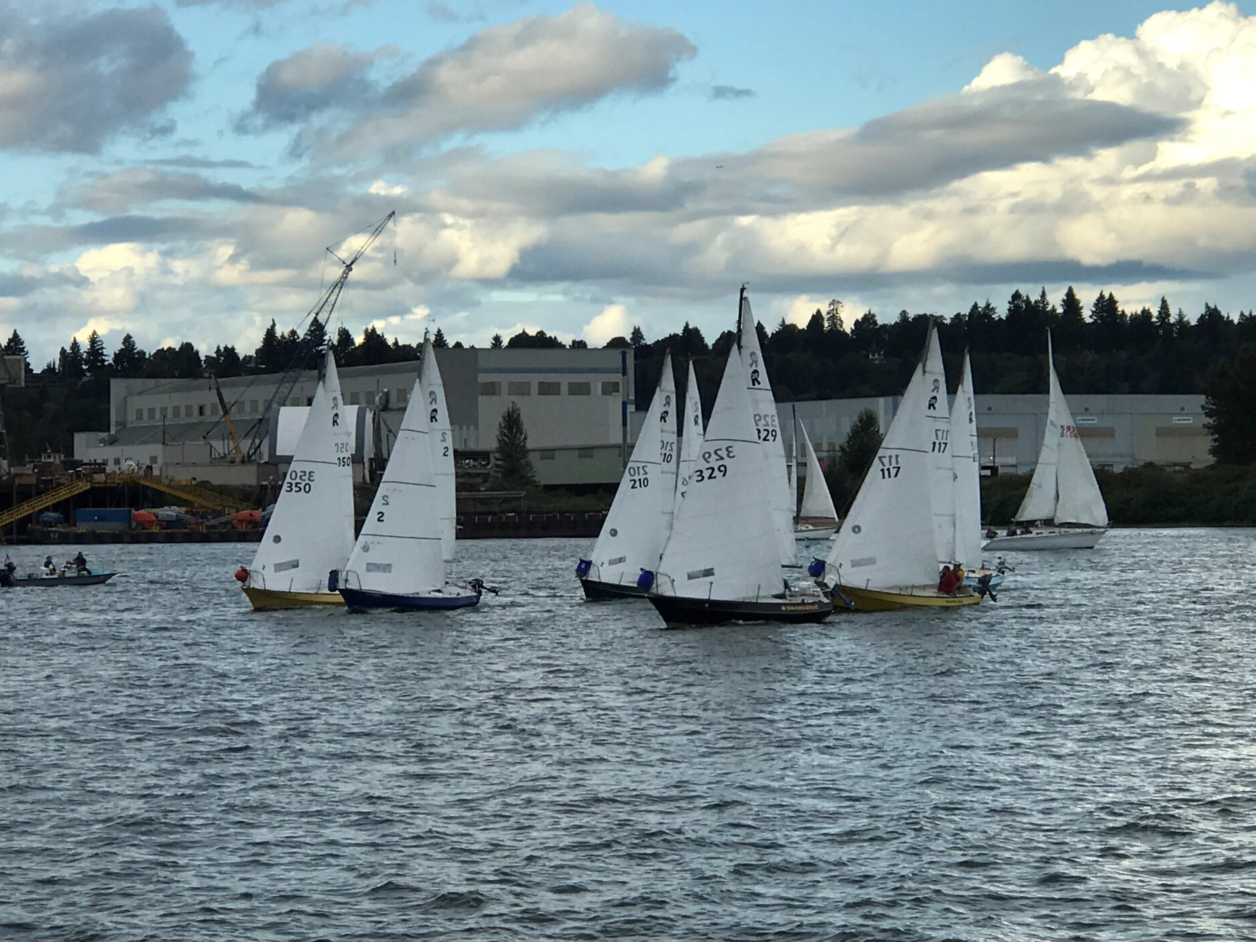
Give each of your crew a responsibility for the Start
Timer – count down from 10 minutes (1 minute intervals), then 30 sec. intervals after 4 minute warning, last minute should be in 10-15 sec. intervals.
Traffic cop – someone who is looking out for other boats
Jib trimmer – responds to skippers commands for jib trim (or luff)

Slide 4
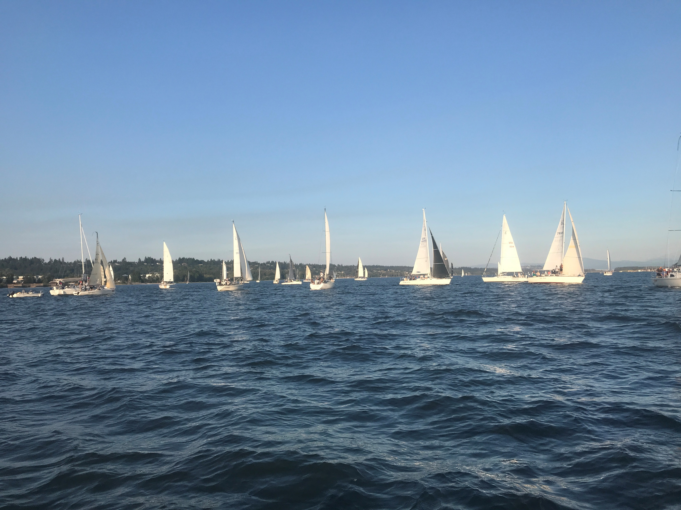
Get out there 30-45 minutes or more before your race start.
Check wind conditions for your sail combination
Get a feel for the current – very important for Spring races
Sail by the buoy and observe
SailFlow will give wind and tide info
Sail the line to determine a favored end (usually pin end)

Slide 5
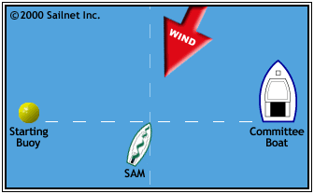
Starting at the Favored End
Favored wind end results in a shorter distance to the windward mark.
Easiest way to find favored wind end is to go to the middle of the line and go head-to-wind. The side your boat is pointed toward is favored end.
Favored end (or middle) might be the part of the line that gets you to the favored side of the course

Slide 6
Be there – important to be in the first tier at the start Concentrate on boat speed immediately after the start
Keep it flat in the puffs
Sail trim is important
Have a person (tactician tell you about other boats)
Getting a good start is important as it pays to get to windward mark in the top three

Slide 7
If you get a bad start be willing to go to Plan B
Be sure to sail in clear air (and move to the favored side of the course)
Tack if necessary – be sure you can tack clear of other boats (OK to go behind them)
Stay calm but energized and have fun
Catalina 22 Nationals on the Columbia

Slide 8
Looking for the Gap in the line

Slide 9
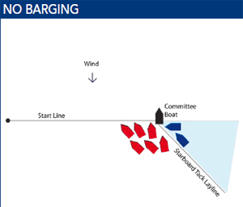
Know your rules and be willing to mix it up. Most important are
Rule 11 Windward boat has to keep clear of leeward boats
Rule 15 Must give boat room to keep clear
Barging – while there is no anti-barging rule, Rule 11 does apply and prevents the blue-boats from squeezing in below the mark.
Don’t hit the Race Committee boat (or starting buoy)

Slide 10
Important Rules at the Start
Rule 11 - ON THE SAME TACK, OVERLAPPED When boats are on the same tack and overlapped, a windward boat shall keep clear of a leeward boat.
Rule 15 - ACQUIRING RIGHT OF WAY When a boat acquires right of way, she shall initially give the other boat room to keep clear, unless she acquires right of way because of the other boat’s actions.
OCSA Rules
11.6 A boat that has not started (e.g., over early) may use propulsion without penalty as long as the boat that does not start for at least 4 minutes after discontinuing propulsion.
11.7 A boat that makes contact with the Race Committee vessel will be scored a DSQ without a hearing.

